Slide 1
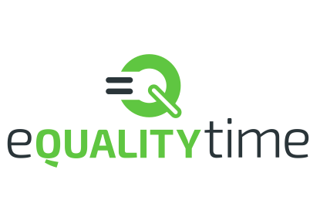

Session 4
Cryptography

Slide 2
What we are going to learn today
How to think about what security you want from a system
What cryptography is about
A bit of cryptography history
What the modern approach to cryptography is

Slide 3

Have you ever voted for something?
If yes, what for?
If no,
Have you elected a school rep?
How do you decide who does the washing up?
How do you decide where you want to go on holiday?
Notes:
Discuss with students

Slide 4
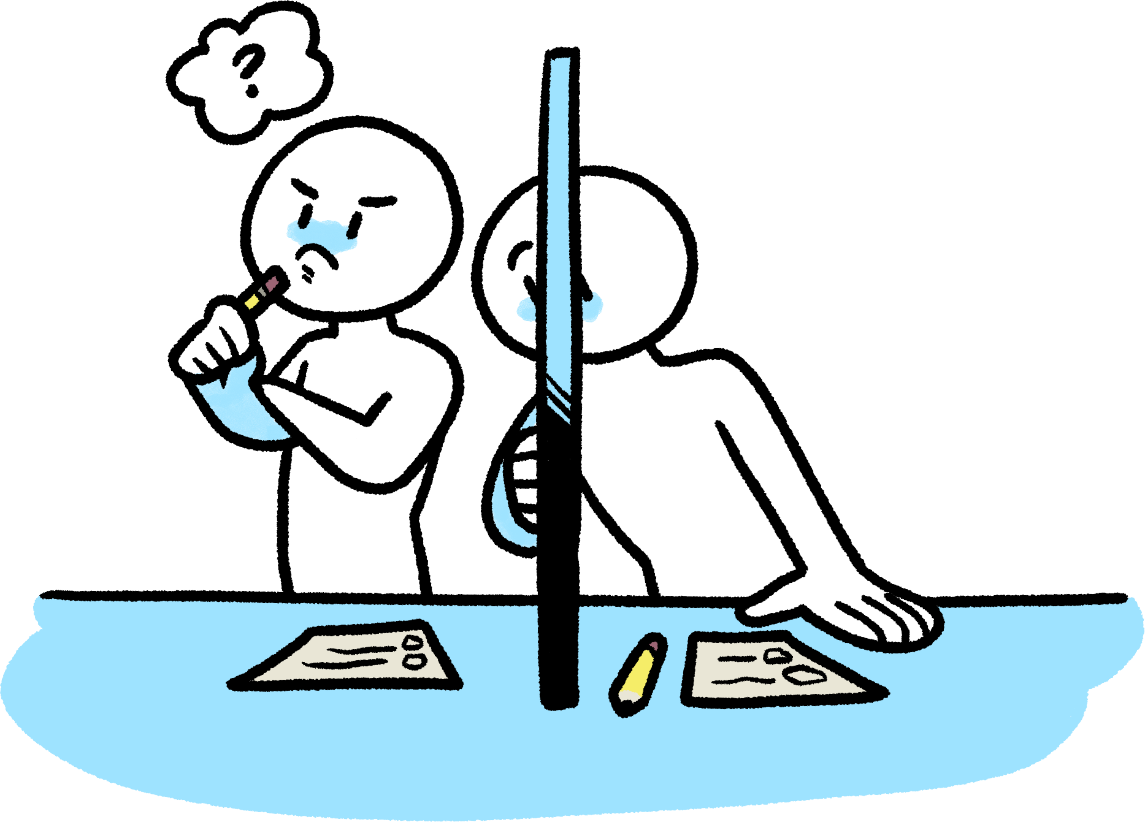
What do you expect from an election?
Some things that might have come up..
You want your vote to be private
You want that only allowed people vote
You want everyone to only vote once
You want the result of the election to be truthful (and that your vote was counted!)
You want your vote to be recorded correctly
…
Notes:
Let the students say and write on board. Then discuss and compare to what on slide.

Slide 5
Cryptography can help with this!!
You want your vote to be private
You want that only allowed people vote
You want everyone to only vote once
You want the result of the election to be truthful (and that your vote was counted!)
You want your vote to be recorded correctly
…
ENCRYPTION
CREDENTIALS/DIGITAL SIGNATURES
ZERO-KNOWLEDGE PROOFS
VERIFIABLE COMPUTATION
MESSAGE AUTHENTICATION PROTOCOLS

Slide 6
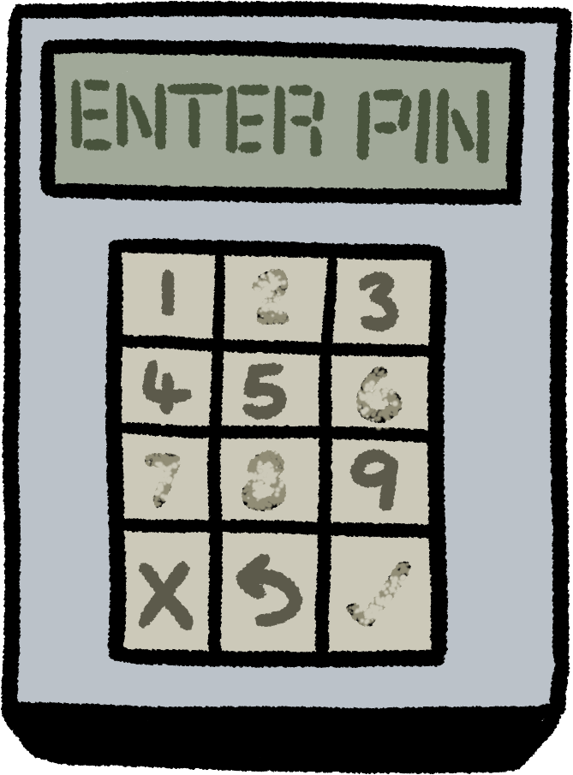
Cryptography is pretty helpful indeed ☺
Why helpful?
Helpful to whom?
Cryptography in today’s world
A range of techniques for ensuring the confidentiality, integrity and origin of data.
Used for mobile phones, chip and pin cards, Internet commerce, and more.
A science, involving a blend of mathematics, statistics,
computer science and engineering:
Advanced encryption
Digital signatures
Key exchange primitives
Secure multi-party computation
Private information retrieval
Electronic elections and auctions…
Notes:
What do you think cryptography is/does?
How do you think you use it?

Slide 7

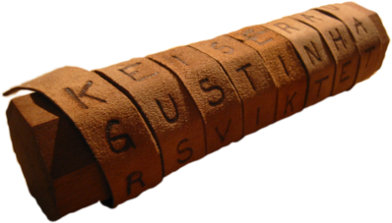
Classical cryptography – from me to you
Historically: making (and breaking) codes and ciphers
Designed to scramble messages so they cannot be read by an enemy.
KEY IDEA in classical crypto
A sender wants to transmit information to a receiver securely, i.e., only the sender and the intended receiver should be able to recover the information.
This is achieved by means of encryption.

Slide 8
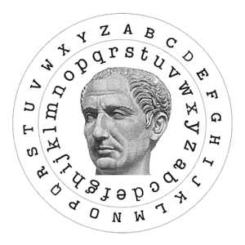
The most famous cipher of them all
In the 1st century BC, a new cipher appeared.
It became known as Caesar’s cipher, since Julius Caesar was one of its most famous users.
IDEA:
Each letter of the message was substituted by one three positions further down the alphabet.
So A becomes…?
And B becomes …?

Slide 9
The Caesar Cipher
Message: YES→ 24 4 18
Encrypted message is …
A | B | C | D | E | F | G | H | I | J | K | L | M
0 | 1 | 2 | 3 | 4 | 5 | 6 | 7 | 8 | 9 | 10 | 11 | 12
N | O | P | Q | R | S | T | U | V | W | X | Y | Z
13 | 14 | 15 | 16 | 17 | 18 | 19 | 20 | 21 | 22 | 23 | 24 | 25
Would you use this cipher?
(it depends, but probably no..)
TAKEAWAY 1: You need many keys.
Notes:
BHV!

Slide 10
Substitution cipher
Pick a random one-to-one mapping of the letters of the alphabet.
A | B | C | D | E | F | G | H | I | J | K | L | M | N | O | P | Q | R | S | T | U | V | W | X | Y | Z
L | Y | N | B | R | G | M | T | Z | S | C | O | A | W | K | F | I | X | P | V | D | Q | U | H | J | E
So the encryption of TUESDAY would be VDRPBLJ.
What would RLPJ decrypt to?
How many keys now?
The number of keys is very large: 26! » 4×10²⁶
Would you use this cipher?

Slide 11
How frequent are you?
MAIN INSIGHT:
If we know what language an encrypted message belongs to, we can analyse a message written in the same language, and count how many times each letter appears.
We can rank letters in order of frequency, and map these to the ranking we perform on the encrypted message.
For example,
in the English language
Top letters are E, T, A
and O.
The same can be done with
digrams (TH, HE, IN, …) and
trigrams (THE, ING, AND, …).
A 8.17% | H 6.09% | O 7.51% | V 0.98%
B 1.49% | I 6.97% | P 1.93% | W 2.36%
C 2.78% | J 0.15% | Q 0.10% | X 0.15%
D 4.25% | K 0.77% | R 5.99% | Y 1.97%
E 12.70% | L 4.03% | S 6.33% | Z 0.07%
F 2.29% | M 2.41% | T 9.06%
G 2.02% | N 6.75% | U 2.76%

Slide 12
Mono vs poly
TAKEAWAY 2: Many keys is not enough.
In the ciphers we have seen so far, once the key is chosen, each plaintext character is mapped to a unique ciphertext character.
For this reason, these ciphers are called monoalphabetic.
For these types of ciphers, frequency analysis works very well.
Designers of ciphers realized they needed to break that unique mapping in order to try and resist frequency analysis.
This led to the introduction of polyalphabetic ciphers.

Slide 13
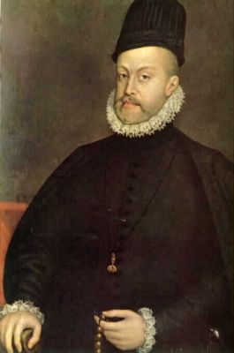
Le chiffre indechiffrable
Blaise de Vigenere, in the XVI century, created the most famous polyalphabetic cipher, which became known as le chiffre indechiffrable, since it took over 300 years to break it.
Map letters to numbers, as usual.
Choose a keyword K of length m.
Add the keyword to the message (e.g., encrypt m letters at a time).
M | B | Y | L | A | N | D | O | R | B | Y | S | E | A
K | W | A | L | K | W | A | L | K | W | A | L | K | W
E | X | Y | W | K | J | D | Z | B | X | Y | D | O | W

Slide 14
Is polyalphabetic ciphers the answer?
In the XIX century, British mathematician Charles Babbage decided to approach the challenging task of deciphering this polyalphabetic cipher.
The key revelation he had was that the length of the chosen keyword determined the number of ciphered alphabets in use.
Here, the keyword length is 4.
Now note what happens to plaintext BY.
From this observation, Babbage proceeded to cryptanalyse the cipher.
M | B | Y | L | A | N | D | O | R | B | Y | S | E | A
K | W | A | L | K | W | A | L | K | W | A | L | K | W
E | X | Y | W | K | J | D | Z | B | X | Y | D | O | W
TAKEAWAY 3: Believing something is secure is not enough.

Slide 15
Saving Caesar
Can we save the simple and easy Caesar cipher?
Use a longer key somehow? What about using a separate key K for each letter?
If the key is as long as the message
AND
The key is completely random
AND
Each key is used only once
THEN
this cipher is pretty good ☺!!!
Message = MAYBE
Key = 17, 5, 13, 21, 7
Encrypted message = DFLWU
M | 12 | 0 | 24 | 1 | 13
K | 17 | 5 | 13 | 21 | 7
E | 3 | 5 | 11 | 22 | 20

Slide 16
Claude Shannon and the One-Time Pad
In 1949 Claude Shannon publishes his famous paper Communication Theory of Secrecy Systems, in which he proves that Vernam’s cipher (aka the one-time pad) is perfectly secret.
Vernam’s cipher
Message
1 | 0 | 1 | 0 | 1 | 1 | 1
Key
1 | 1 | 0 | 0 | 0 | 0 | 1
Ciphertext
0 | 1 | 1 | 0 | 1 | 1 | 0
The message is perfectly hidden!

Slide 17
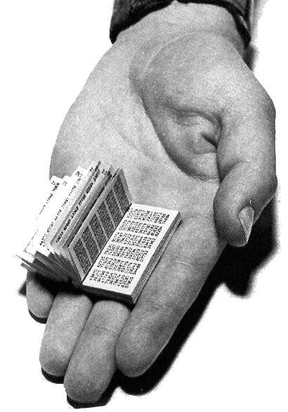
Are we done?
Vernam’s cipher achieves perfect secrecy, but there are conditions on the key.
The key is as long as the message
The key is random
The key can be used only once
Not very practical!
TAKEAWAY 4: We need balance between security and efficiency.

Slide 18
Back to elections..
Now that you know a bit more about cryptography, would you use a cryptographically-enabled electronic voting scheme to express your vote in an online election?
For me, it depends…
https://vote.heliosvoting.org/
Helios: open source, web-based, used in many real-world applications…
Good for low-coercion environments 🡪 see threat modelling from last week!
COERCION-RESISTANT protocols: work in progress ☺

Slide 19
Not just encryption..
Would you use cryptography to…
Pay in Bitcoins (or your favourite crypto currency)?
Message on Whatsapp?
Access The Guardian website?
Well, you do! Each of these applications uses some underlying cryptography.
And each of these cryptographic tools and systems requires a definition and security model so that we can provide some formal guarantee of security.
PROVABLE SECURITY
TAKEAWAY 5: Modern cryptography requires proofs!

Slide 20
Thanks!
TAKEAWAY 6: If you are excited about cryptography
– great! So am I!
Get in touch! Elizabeth.Quaglia@rhul.ac.uk

